Slide 1
Internal Presenter Notes: What Attendees Should Take Away
Content creators: Write 3 things an attendee should take away from the presentation. This will help presenters home in on the main points.
1. Basics of Octopus Deploy
2. How to complete your first deployment
3. Introduce more advanced features

Slide 2

Let’s Get Deploying!
Sarah Lean
Senior Solutions Architect @Techielass

Slide 3



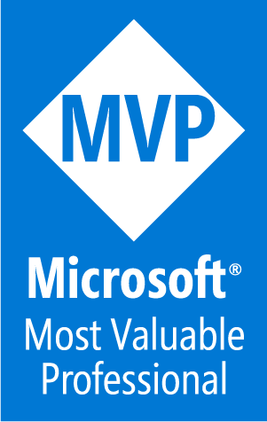
Who am I?
Blog at www.techielass.com
@Techielass
Founder of the Glasgow Azure User Group
STEM Ambassador
17+ years in the IT industry
IT Pro

Slide 4


Slide 5
What is Octopus Deploy?

Slide 6
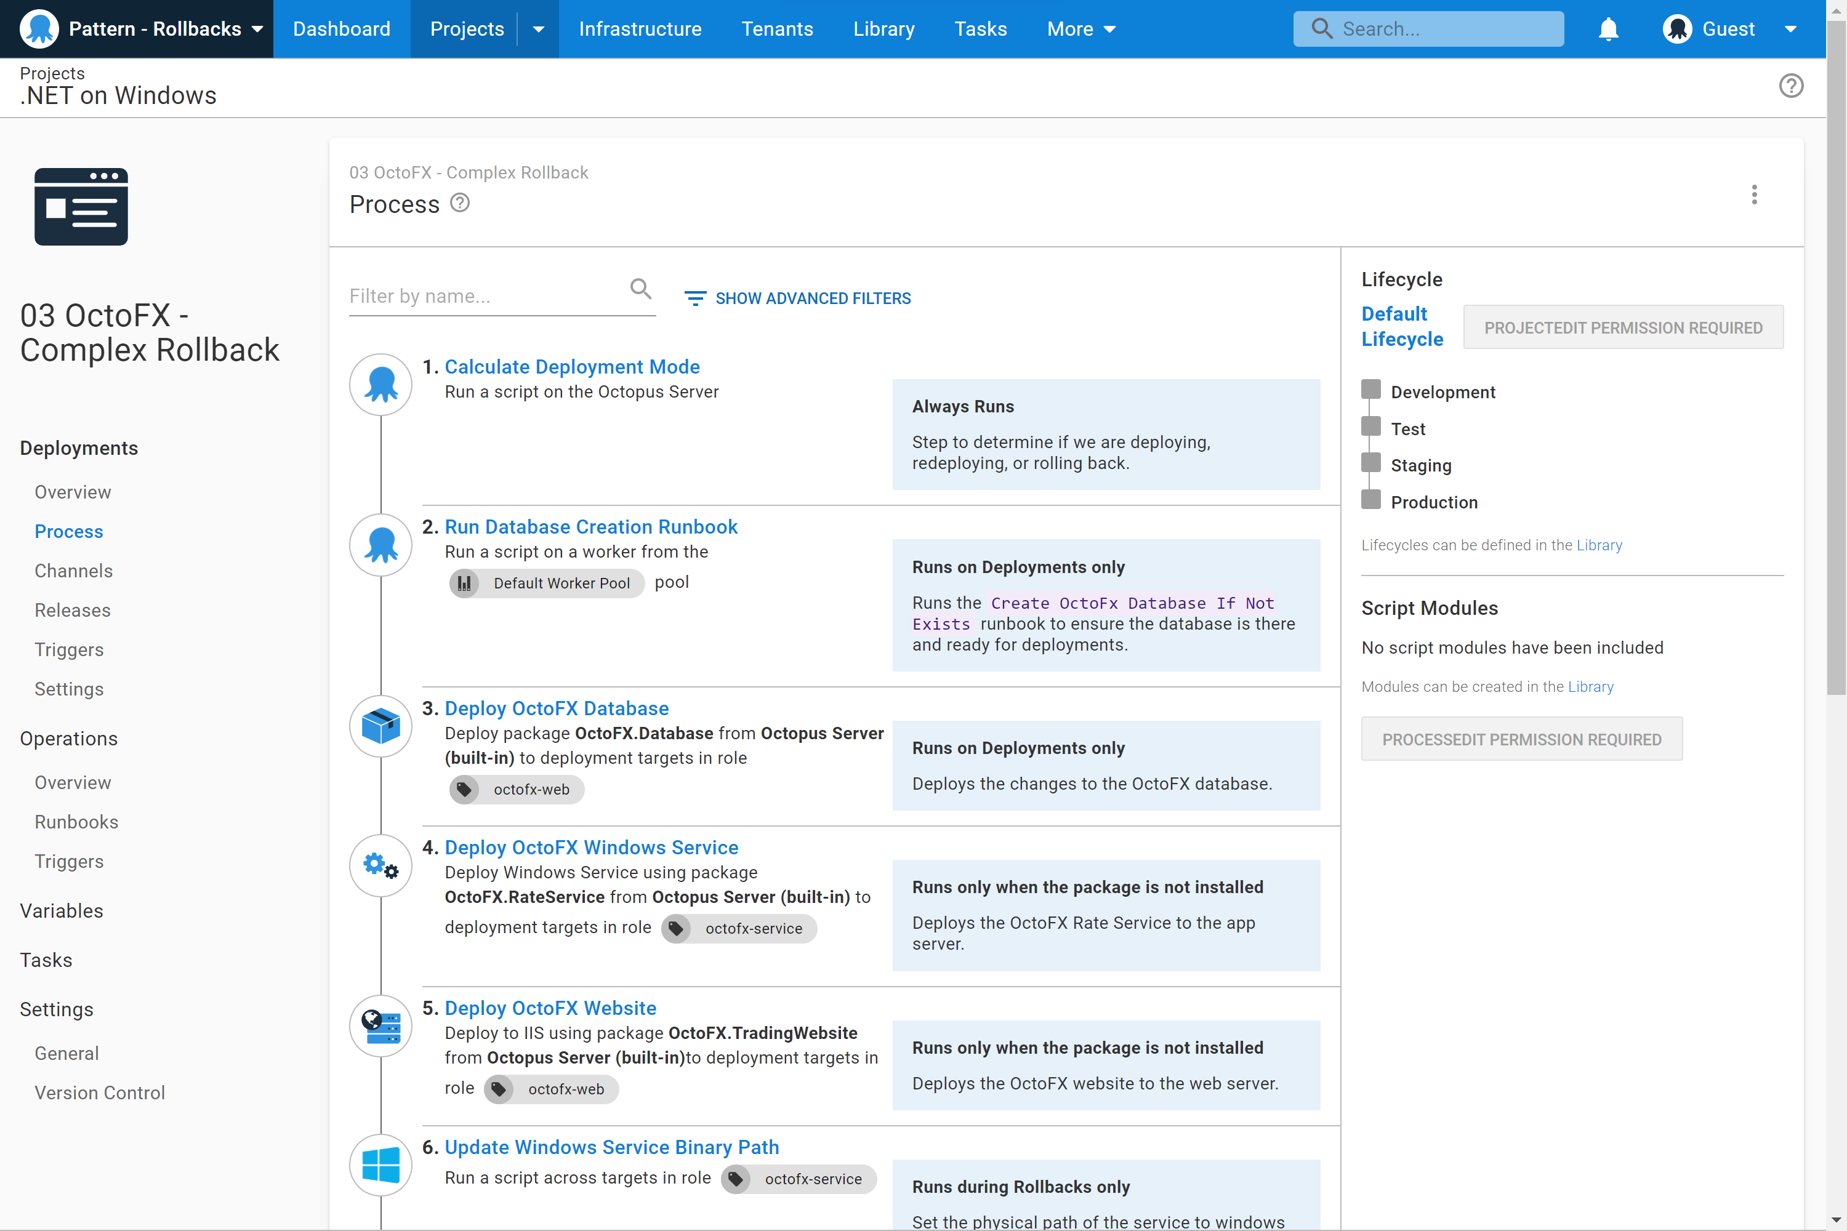
What is Octopus Deploy?
A unified DevOps Automation platform.
Octopus Deploy is a single place for your team to manage releases, automate deployments, and automate the runbooks that keep your software operating.

Slide 7
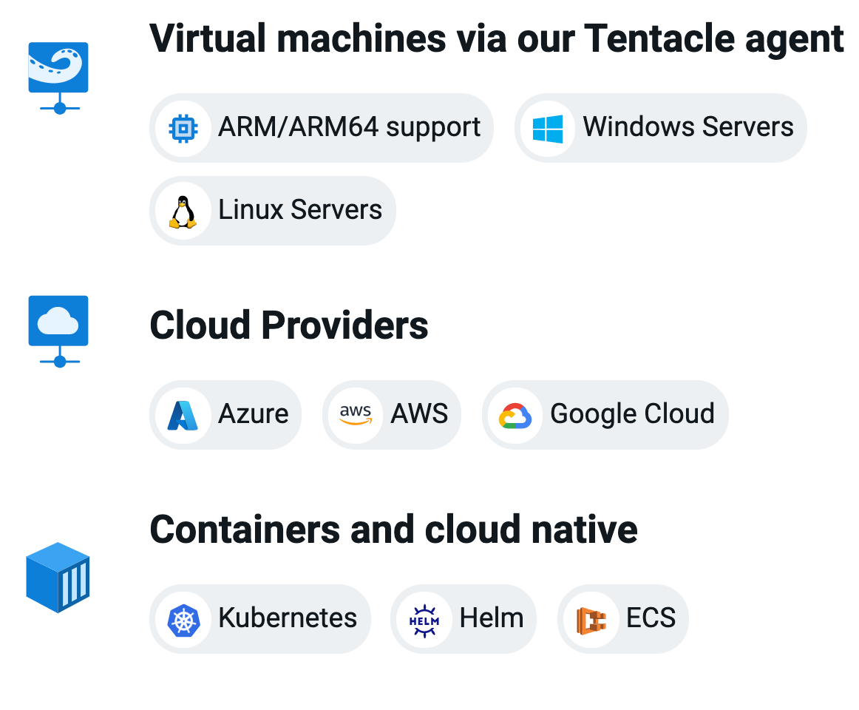
Run on any infrastructure
Support for legacy to modern infrastructure from virtual machines to containers
Cloud agnostic with built-in functionality for Azure, AWS, and Google Cloud
Support for all major CI servers with native plugins including Jenkins, GitHub Actions, Jetbrains TeamCity, Azure DevOps and more

Slide 8
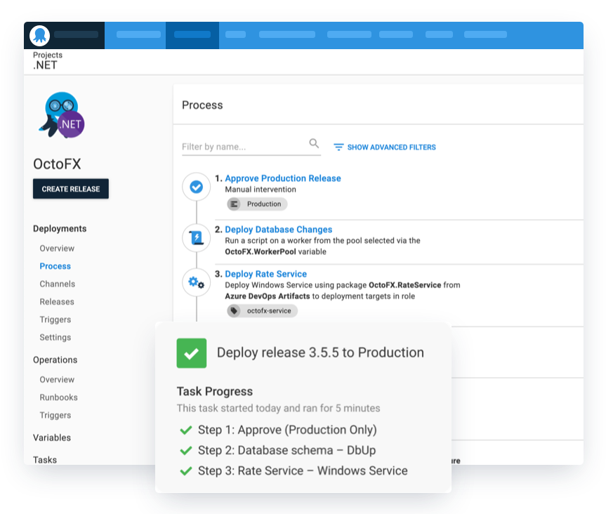
Define your deployment process once
Differences are handled via variables and scoping steps to specific environments
Releases snapshot your deployment configuration and build artifacts for repeatable and reliable deployments
Advanced deployment patterns including rolling, blue-green, canary deployments and multi-tenancy

Slide 9
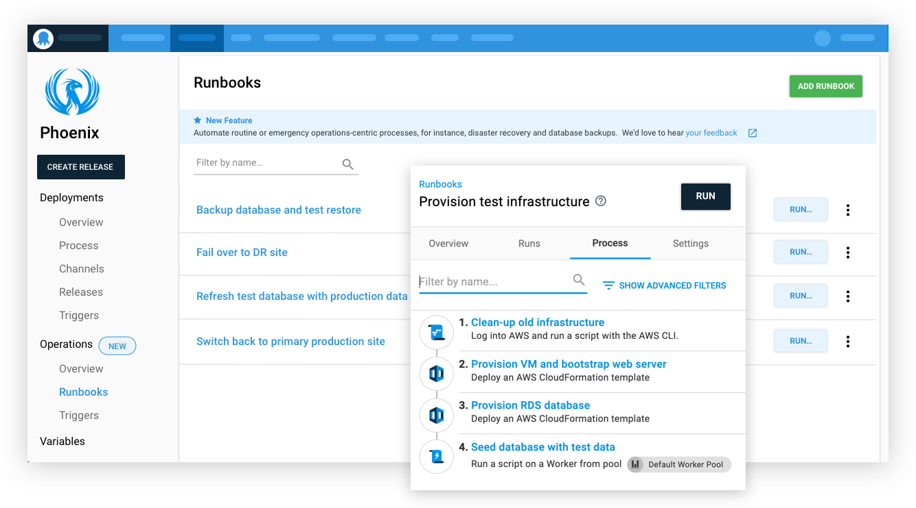
Runbooks
Runbooks allow teams to automate routine maintenance and incident management (emergency) operations tasks

Slide 10
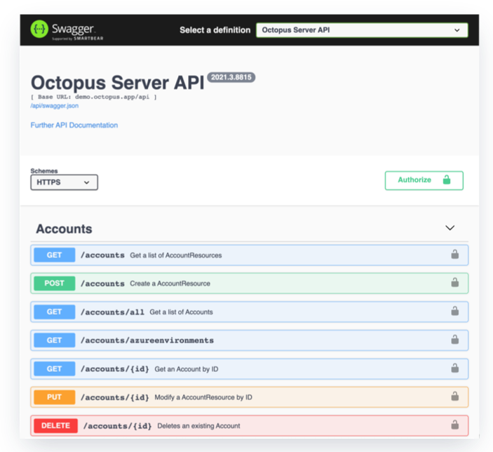
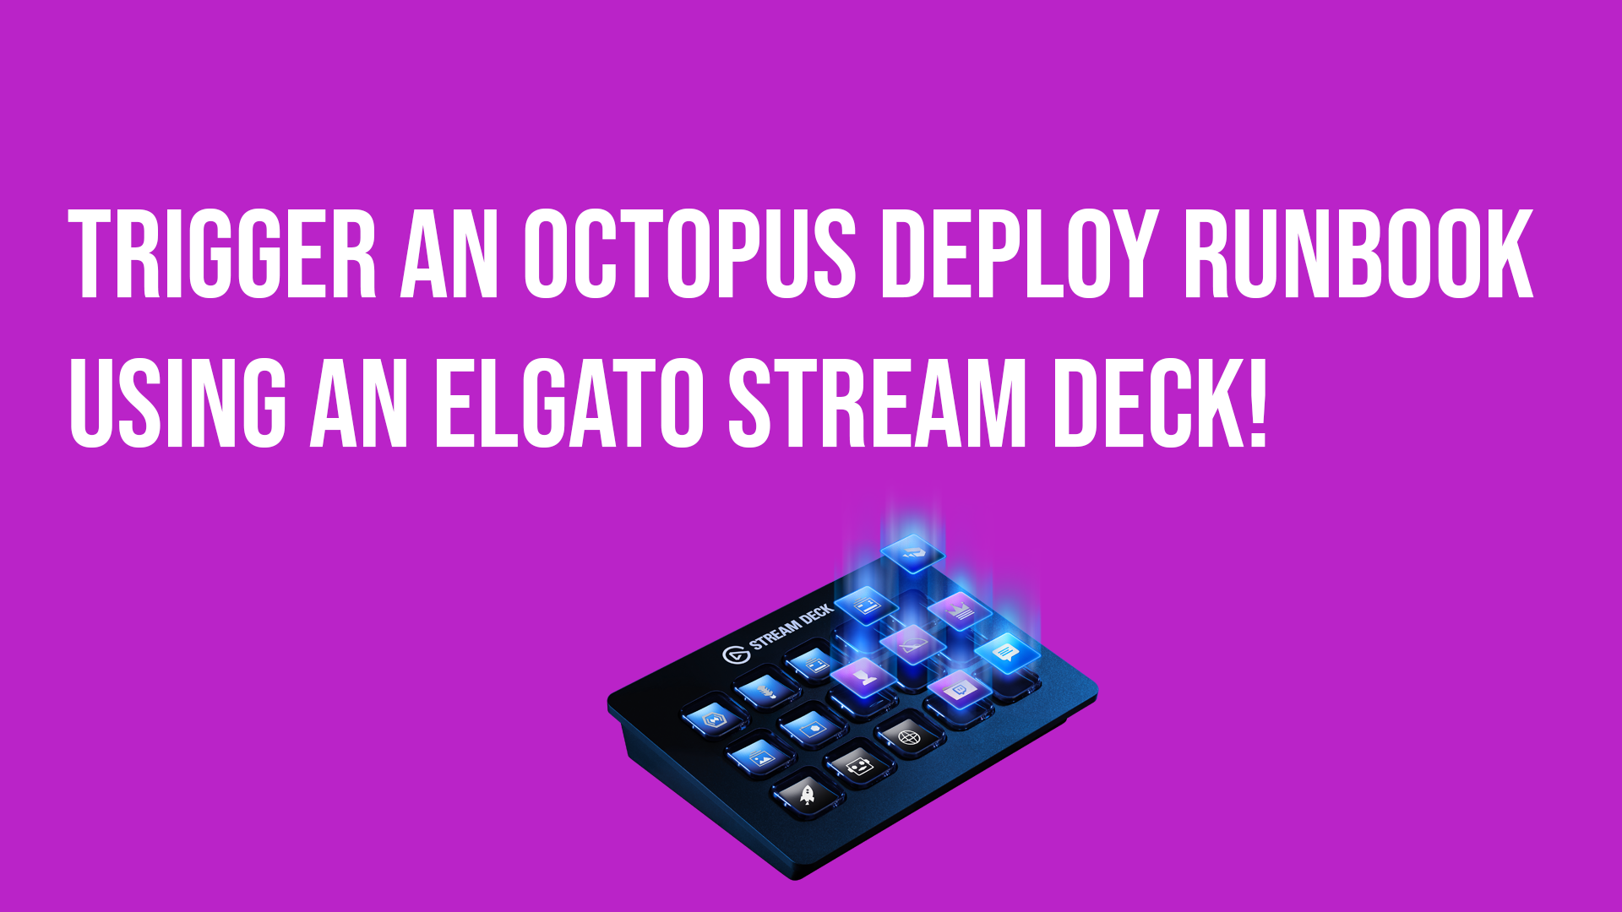
API-first architecture
API-first architecture for automation, customization and flexibility
Cross-platform integrations that suit your team. Octopus CLI, RESTful client, C# API client, Java SDK, Golang API client, and TypeScript API client

Slide 11
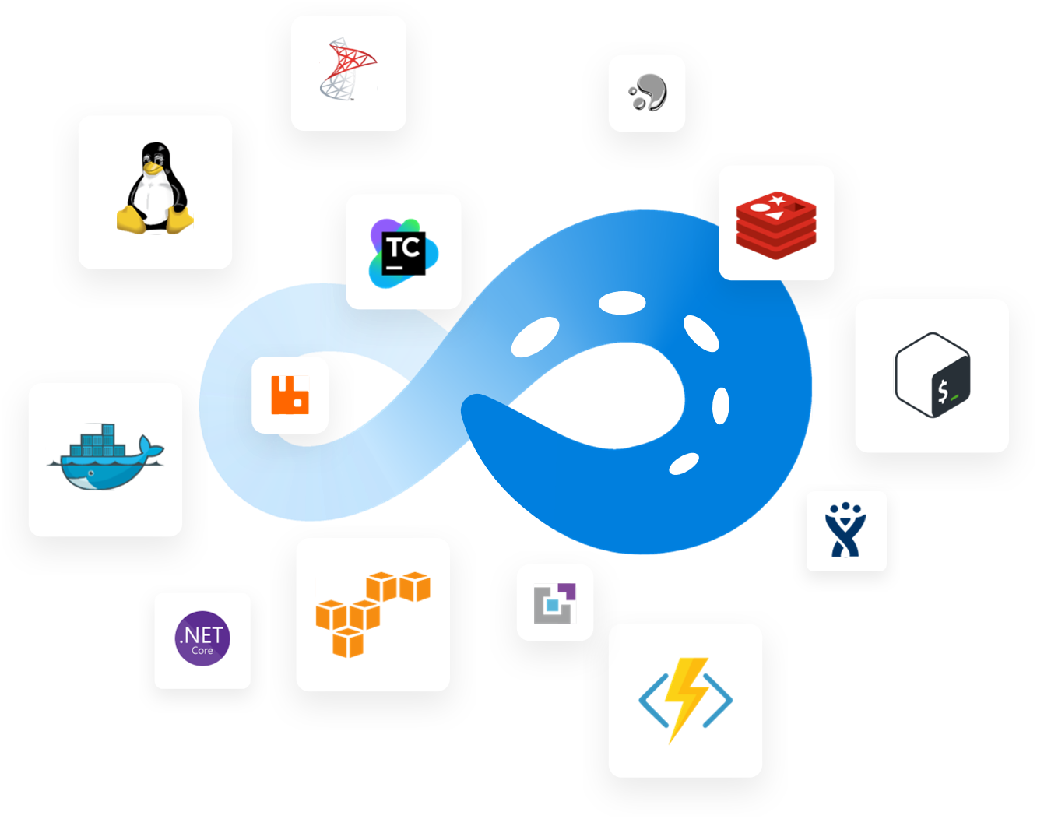
Step Integrations
Access to 500+ automation tasks and easy integration with hundreds of key technologies.

Slide 12
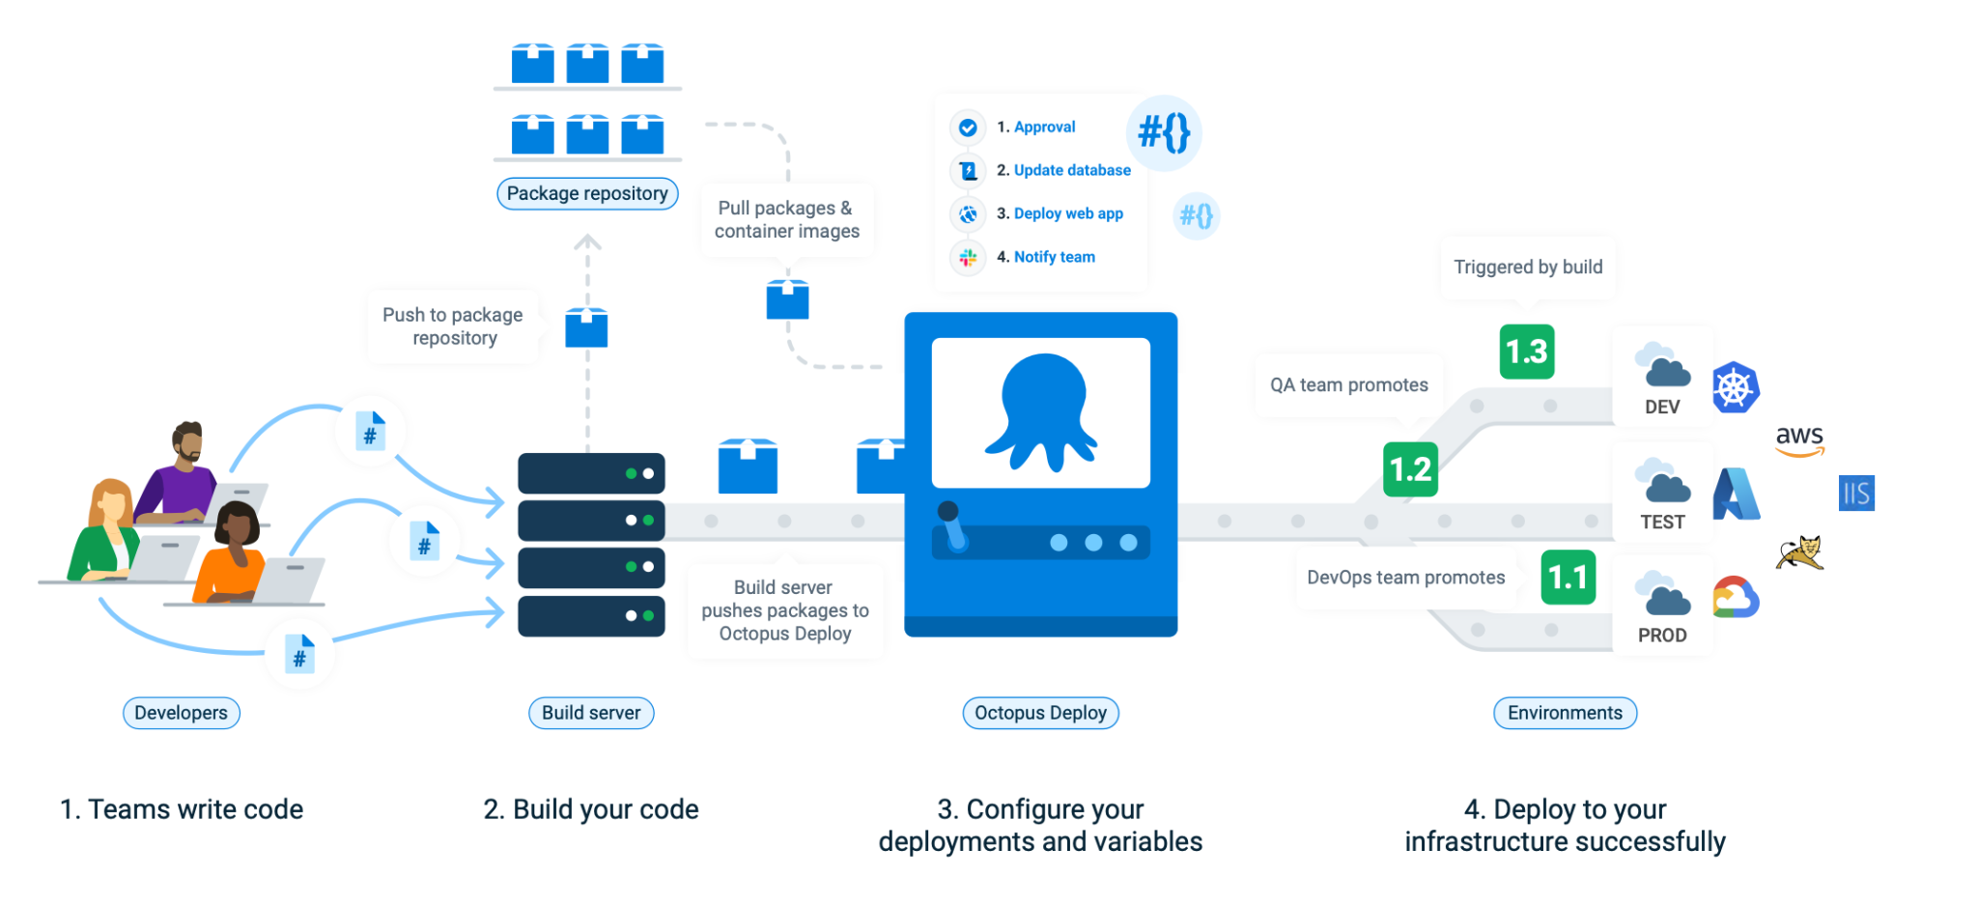
Where does Octopus fit?

Slide 13
DEMO

Slide 14
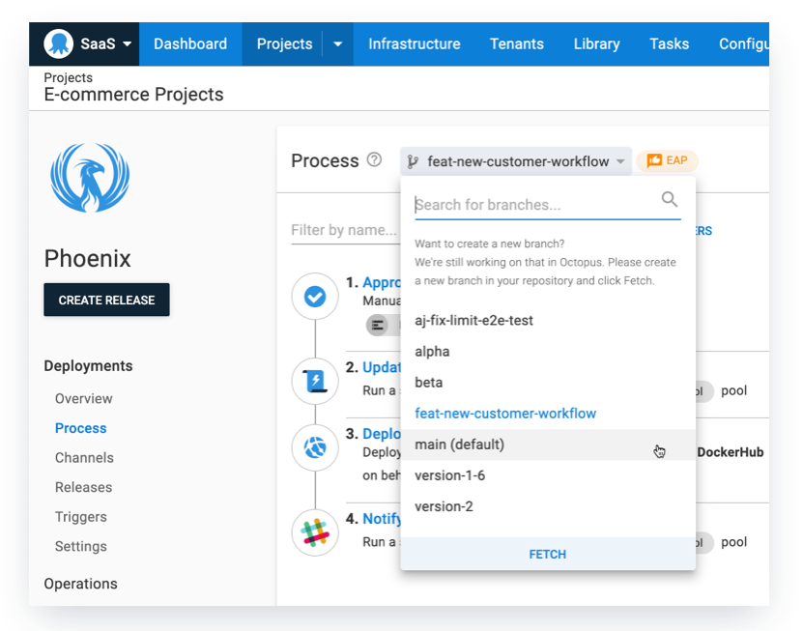
Config as Code
Version control your deployment process.

Slide 15
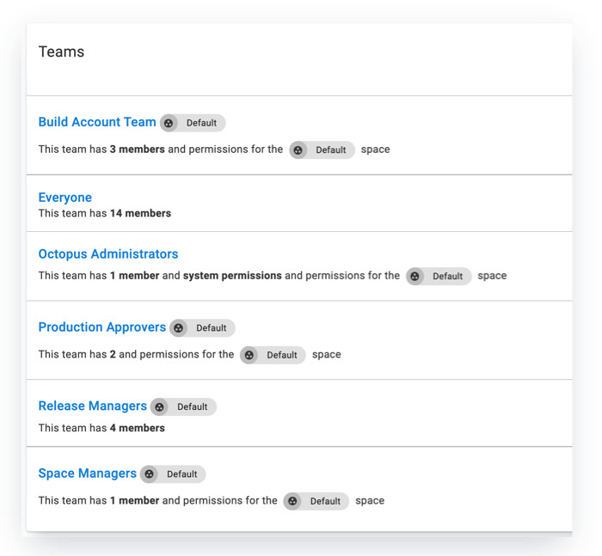
Meet compliance requirements
Role-based access control.
Support for external Authentication providers
Notifications
ISO 27001 and SOC II Type II certification in progress

Slide 16



Our Focus for 2022
Octopus Cloud Improvements
More Cloud Native Targets
Modern DevOps with Everything-as-Code
https://www.octopus.com/roadmap

Slide 17
What did you learn?
What Octopus Deploy is
How to deploy Infrastructure as Code
How to deploy your application code
Where Octopus Deploy fits in the tech stack

Slide 18

Thank you! Resources: https://oc.to/letsgetdeploying
Sarah Lean
Senior Solutions Architect
@Techielass
www.techielass.com

